Slide 1
Komputer dan masyarakat
Chapter 7
Home, Work, and Ethical Issues
Ulya Anisatur, M.Kom

Slide 2
Komputer dan masyarakat
Memahami bahwa komputer telah membuat perbedaan yang luar biasa dalam kehidupan sehari-hari
Menjelaskan bagaimana komputer mengubah cara masyarakat berinteraksi dengan disiplin ilmu seperti pendidikan, hiburan , keuangan, pemerintah, kesehatan, ilmu pengetahuan, penerbitan, dan wisata
Menjelaskan bagaimana komputer digunakan di rumah
Kenali masalah yang terkait dengan kesenjangan digital
Memahami bagaimana e-commerce mempengaruhi cara orang melakukan bisnis
Pelajari cara untuk mencegah dengan kesehatan gangguan terkait dan cedera akibat penggunaan komputer
Mengidentifikasi cara virtual reality, agen cerdas, dan robot yang digunakan dalam kehidupan sehari-hari
Memahami bagaimana merancang ruang kerja ergonomis
Memahami isu-isu etis seputar penggunaan komputer

Slide 3
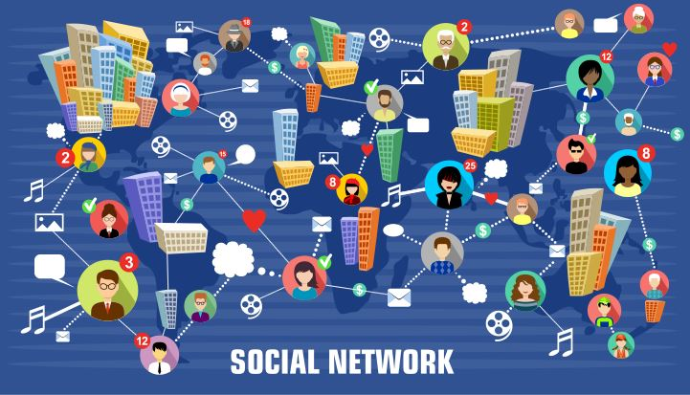
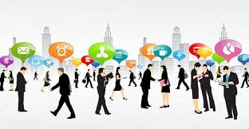
Hidup dengan komputer
Social Community
- Daniel Bell (1977)
- Manuel Castells (1996)
Notes:
Bell - masyarakat pasca-industrial dan Castells - zaman informasi
Pervasive adalah suatu bentuk dimana teknologi telah menyatu terhadap pemakai teknologi dan lingkungannya sehingga teknologi tersebut bukan suatu hal yang khusus

Slide 4
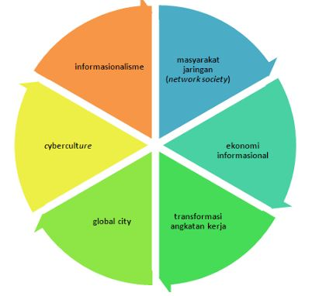
Hidup dengan komputer
Social Community
ICT (Information & Communication Technology)

Slide 5
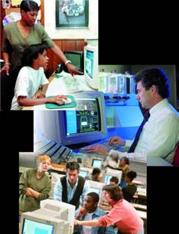
Hidup dengan komputer
How has society benefited from the computer?
1/3 dari pertumbuhan ekonomi dikaitkan dengan teknologi digital
Pengguna dapat membuat baik-informasi keputusan karena akses cepat ke informasi dari mana saja
Siswa memiliki lebih banyak alat untuk membantu mereka dalam proses belajar

Slide 6
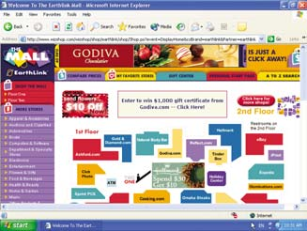
Hidup dengan komputer
How are computer used at home?
Entertainment
Research and Education
Budgeting, personal financial management and home business management
Web access
Personal and business communications

Slide 7
Hidup dengan komputer
What is the main reason computers have infiltrated?
Web based news, research
Distance education
Entertainment and Leisure
Online shopping
Download and listen to music
Communication with others around the world
Bank and invest
Download and watch movies

Slide 8
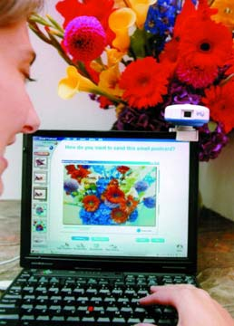
Hidup dengan komputer
How have computers changed home communications?
Transmit text, voice, sound, video and graphic over web
PC Camera
Built-in microphone

Slide 9
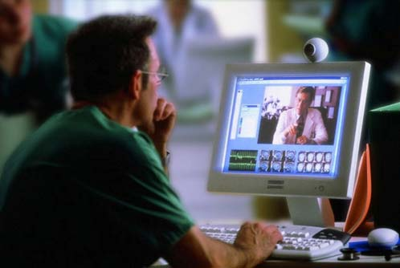
Hidup dengan komputer
What is the purpose of video conferencing software?
Have live conversations with others
h
PC Camera
Picture of person he is talking to

Slide 10
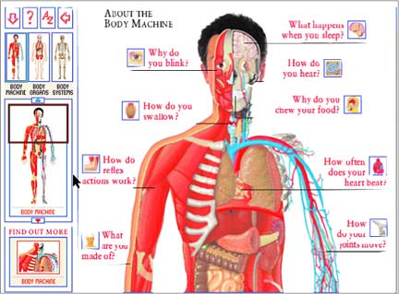
Hidup dengan komputer
What is computer-based training (CBT)?
Learn by using computers with Instructional software
Also called computer-aided instruction (CAI)
Web-based training (WBT) uses Internet technology

Slide 11
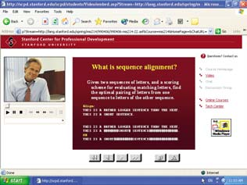
Hidup dengan komputer
What is distance learning (DL)?
Delivery at one location and learning at another
Most colleges offer some form of distance learning; some Include degrees
Notes:
Pendidikan jarak jauh

Slide 12
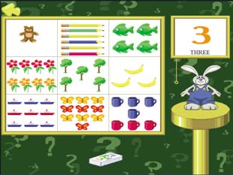
Hidup dengan komputer
What is edutainment?
Type of educational software combining education with entertainment

Slide 13
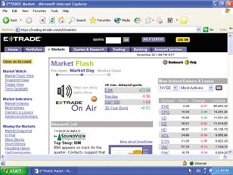
Hidup dengan komputer
What is online stock trading?
Buy and sell stocks online without using a broker
Organize investments
Set up alerts

Slide 14
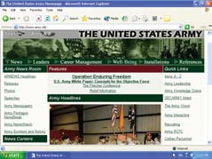
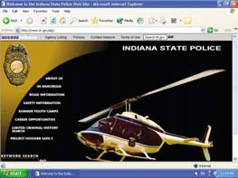
Hidup dengan komputer
How does the government use computers?
Government Web sites provide citizens with up-to-date information

Slide 15
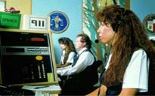
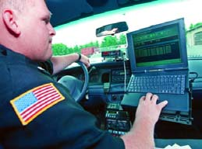
Hidup dengan komputer
How do government employees use computers as part of their daily routine?
911 call center
Police have online access to FBI Center (NCIC) via police cars equipped with computers and fingerprint scanners

Slide 16
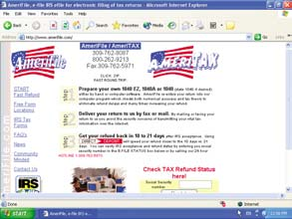
Hidup dengan komputer
What are other uses of computers in government?
Government Web sites allow you to
– file taxes
– apply for permits and licenses
– pay parking tickets

Slide 17
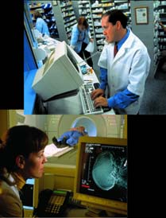
Hidup dengan komputer
How are computers used in health care?
Maintain and share records
Monitor patient’s vital signs
Assist in research and diagnosis
File insurance claims
Conduct medical tests
Communicate with patients
Surgically implant computerized devices
Assist in operations with computer-controlled devices
Aid in surgery

Slide 18
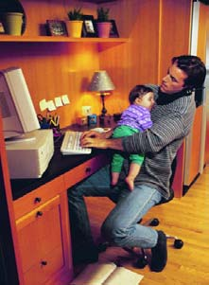
Hidup dengan komputer
What are reasons to telecommute?
Reduce time and expense spent in traveling to office
Eliminate travel during unsafe weather conditions
Allow flexible work schedule
Provide convenient, comfortable work environment
Advantages
– Higher job satisfaction rates
– More productive workers
– Reduction in employer overhead
– Healthy for environment

